Slide 1
jQuery with AJAX
Write Less Do More

Slide 2
Agenda
jQuery – AJAX
Global Event Handlers
Helper Functions
Low level interface
Shorthand methods
jQuery AJAX Functions
jQuery AJAX Example
Samples

Slide 3
jQuery - AJAX
jQuery has a rich library of methods (functions) for AJAX development.
What is AJAX?
Asynchronous JavaScript and XML. A technique for creating fast and dynamic web pages.
AJAX and jQuery
jQuery provides a rich set of methods for AJAX web development.
With jQuery AJAX, you can request TXT, HTML, XML or JSON data from a remote server using both HTTP Get and HTTP Post.
And you can load remote data directly into selected HTML elements of your web page!
Notes:
jQuery has a rich library of methods (functions) for AJAX development
AJAX allows web pages to be updated asynchronously by exchanging small amounts of data with the server behind the scenes.
This means that it is possible to update parts of a web page, without reloading the whole page.

Slide 4
jQuery - AJAX
jQuery has series of functions which provides the common interface for AJAX, regardless the browser.
Most of the AJAX function has a common layout
$.func(url[,params][,callback]),[] Optional
url – string representing the server target
params – names & values send to the server
callback – function to be executed on successful completion.

Slide 5
jQuery - AJAX
Write Less, Do More
$(selector).load(url,data,callback)
Low Level AJAX
$.ajax(options)
Ex: $.ajax({url:"demo_ajax_load.txt",success:function(result){
$("div").html(result);
}});
AJAX Methods
Request | Description
$(selector).load(url,data,callback) | Load remote data into selected elements
$.ajax(options) | Load remote data into an XMLHttpRequest object
Notes:
jQuery has a rich library of methods (functions) for AJAX development
AJAX allows web pages to be updated asynchronously by exchanging small amounts of data with the server behind the scenes.
This means that it is possible to update parts of a web page, without reloading the whole page.
Write Less, Do More
The jQuery load() method is a simple (but very powerful) AJAX function. It has the following syntax:
$(selector).load(url,data,callback)
Use the selector to define the HTML element(s) to change, and the url parameter to specify a web address for your data.
Low Level AJAX
$.ajax(options) is the syntax of the low level AJAX function.
$.ajax offers more functionality than higher level functions like load, get, and post, but it is also more difficult to use.
The option parameter takes name|value pairs defining url data, passwords, data types, filters, character sets, timeout and error functions.

Slide 6
Global Event Handlers
.ajaxComplete()
Syntax
.ajaxComplete( handler(event, XMLHttpRequest, ajaxOptions) )
Example
<div class="trigger">Trigger</div> <div class="result"></div> <div class="log"></div> $('.log').ajaxComplete(function() { $(this).text('Triggered ajaxComplete handler.'); });

Slide 7
Global Event Handlers
.ajaxError()
Syntax
.ajaxError( handler(event, jqXHR, ajaxSettings, thrownError) )
Example
<button class="trigger">Trigger</button> <div class="result"></div> <div class="log"></div> $("div.log").ajaxError(function() { $(this).text( "Triggered ajaxError handler." ); });

Slide 8
Global Event Handlers
. .ajaxSend()
Syntax
.ajaxSend( handler(event, XMLHttpRequest, ajaxOptions) )
Example
<button class="trigger">Trigger</button> <div class="result"></div> <div class="log"></div> $('.log').ajaxSend(function() { $(this).text('Triggered ajaxSend handler.'); });

Slide 9
Global Event Handlers
.ajaxStart()
Syntax
.ajaxStart( handler() )
Example
<button class="trigger">Trigger</button> <div class="result"></div> <div class="log"></div> $('.log').ajaxStart(function() { $(this).text('Triggered ajaxStart handler.'); });

Slide 10
Global Event Handlers
.ajaxStop()
Syntax
.ajaxStop( handler() )
Example
<button class="trigger">Trigger</button> <div class="result"></div> <div class="log"></div> $('.log').ajaxStop(function() { $(this).text('Triggered ajaxStop handler.'); });
.ajaxSuccess()

Slide 11
Global Event Handlers
Syntax
.ajaxStop( handler() )
Example
<button class="trigger">Trigger</button> <div class="result"></div> <div class="log"></div> $('.log').ajaxStop(function() { $(this).text('Triggered ajaxStop handler.'); });
.ajaxSuccess()

Slide 12
Global Event Handlers
.ajaxSuccess()
Syntax
.ajaxSuccess( handler(event, XMLHttpRequest, ajaxOptions) )
Example
<button class="trigger">Trigger</button> <div class="result"></div> <div class="log"></div> $('.log').ajaxSuccess(function() { $(this).text('Triggered ajaxSuccess handler.'); });

Slide 13
Helper Functions
jQuery.param()
Syntax
jQuery.param( obj )
jQuery.param( obj, traditional )
Example
jQuery.param(params);
.serialize()
Syntax
.serialize()
Example

Slide 14
Helper Functions
.serializeArray()
Syntax
.serializeArray()
Example
($input).serializeArray()

Slide 15
Lower Level Interfaces
jQuery.ajax()
Syntax
jQuery.ajax( url, [ settings ] )
jQuery.ajax( settings )
Settings
async
beforeSend(jqXHR, settings)
cache
complete(jqXHR, textStatus)
contents
context
dataType

Slide 16
Lower Level Interfaces
jQuery.ajaxPrefilter()
Syntax
jQuery.ajaxPrefilter( [ dataTypes ], handler(options, originalOptions, jqXHR) )
Example
$.ajaxPrefilter( function( options ) { if ( options.crossDomain ) { options.url = "http://mydomain.net/proxy/" + encodeURIComponent( options.url ); options.crossDomain = false; } });
jQuery.ajaxSetup()
Syntax
jQuery.ajaxSetup( options )
Example
$.ajaxSetup({ url: "/xmlhttp/", global: false, type: "POST" }); $.ajax({ data: myData });

Slide 17
Shorthand methods
jQuery.get()
Syntax
jQuery.get( url, [ data ], [ success(data, textStatus, jqXHR) ], [ dataType ] )
Example
$.get('ajax/test.html', function(data) { $('.result').html(data); alert('Load was performed.'); });

Slide 18
Shorthand methods
jQuery.getJSON()
Syntax
jQuery.getJSON( url, [ data ], [ success(data, textStatus, jqXHR) ] )
Example
$.getJSON('ajax/test.json', function(data) { var items = []; $.each(data, function(key, val) { items.push('<li id="' + key + '">' + val + '</li>'); }); $('<ul/>', { 'class': 'my-new-list', html: items.join('') }).appendTo('body'); });

Slide 19
Shorthand methods
jQuery.getScript()
Syntax
jQuery.getScript( url, [ success(data, textStatus) ] )
Example
$.getScript('ajax/test.js', function() { alert('Load was performed.'); });

Slide 20
Shorthand methods
.load()
Syntax
.load( url, [ data ], [ complete(responseText, textStatus, XMLHttpRequest) ] )
Example
$('#result').load('ajax/test.html', function() { alert('Load was performed.'); });

Slide 21
Shorthand methods
jQuery.post()
Syntax
jQuery.post( url, [ data ], [ success(data, textStatus, jqXHR) ], [ dataType ] )
Example
$.post('ajax/test.html', function(data) { $('.result').html(data); });

Slide 22
jQuery AJAX functions
$.func(url[,params][,callback])
$.get
$.getJSON
$.getIfModified
$.getScript
$.post

Slide 23
jQuery AJAX functions
$(selector), inject HTML
Load
LoadIfModified
$(selector), AJAX Setup Alts
ajaxComplete
ajaxError
ajaxSend
ajaxStart
ajaxStop
ajaxSuccess

Slide 24
jQuery AJAX functions
$.ajax, $.ajaxSetup
async
beforeSend
complete
contentType
data
dataType
error
global
IfModified
processData
success
timeout
type
url

Slide 25
jQuery AJAX Example
$.get(“booknames.jsp”, {queryStr: “AJAX”, f: $(this).attr(“ID”)});

Slide 26
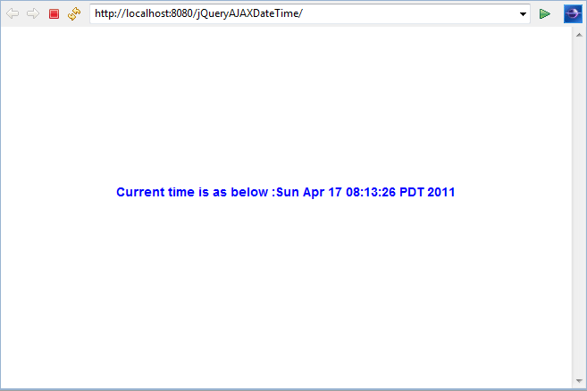
Samples – Date Time (Get)

Slide 27
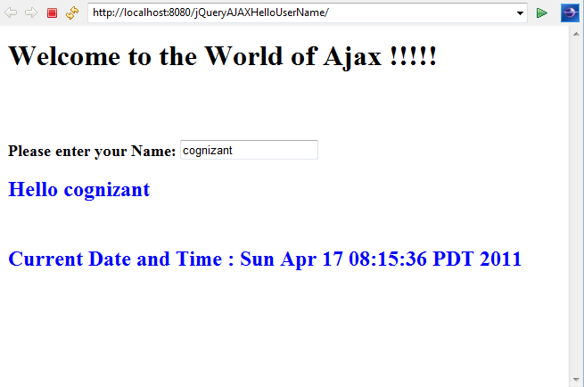
Samples – HelloUserName (Get)

Slide 28
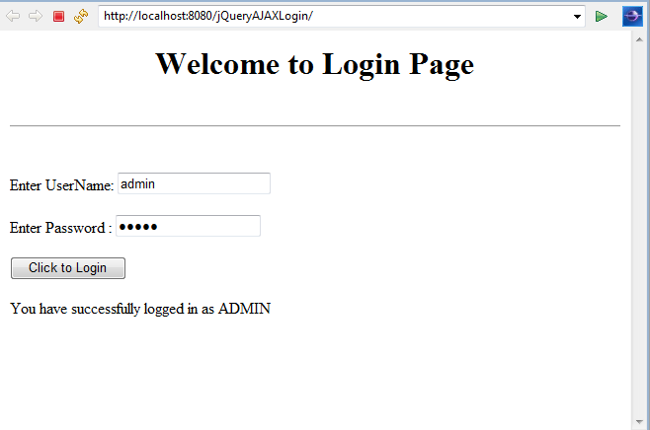
Samples – Login Page (Post)

Slide 29
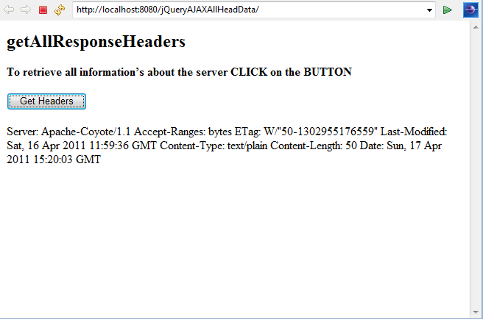
Samples – All Header Data (Post)

Slide 30
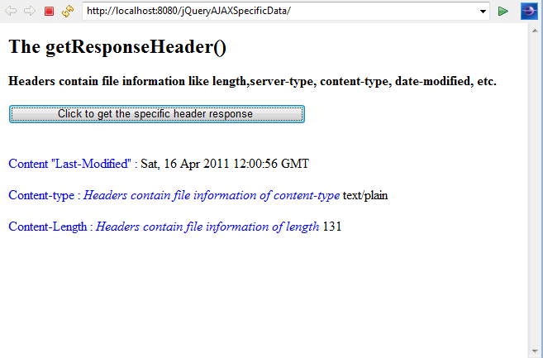
Samples – Specific Data (Get)

Slide 31
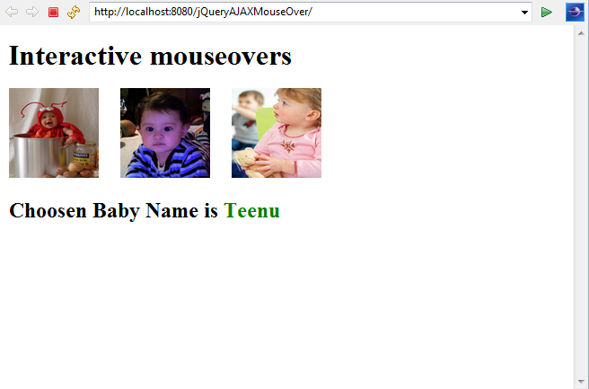
Samples – Mouse Over (Get)

Slide 32
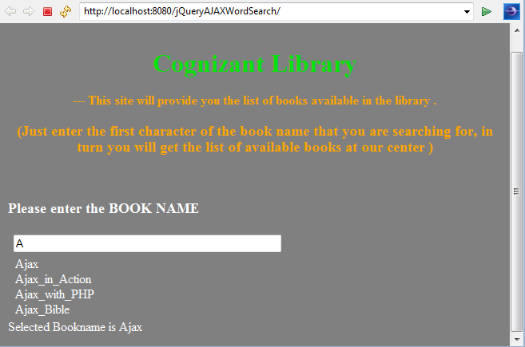
Samples – Word Search (Get)

Slide 33
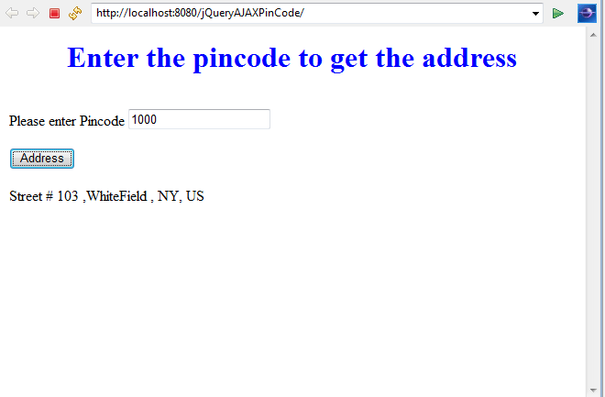
Samples – Pin code (Post)

Slide 34
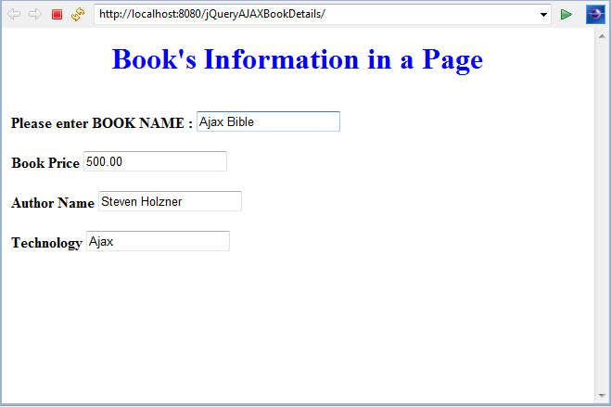
Samples – Book details

Slide 35
Q & A

